Slide 1


SOFTWARE TO SUPPORT THE ACTIVITIES OF THE REGISTRATION CLERK AT “FUTURE ROCK STARS” (FURS) Software Development Project IST 303 FALL 2017
Yu Kao
Imad Fahim
Yaser Alhasawi
Christoffer Gamborg

Slide 2
Outline
Milestone 2.0
Requirements
User Stories
Estimations
Velocity
Milestone 2.0/Iteration
Flow chart
Testing
Project Board
Demonstration

Slide 3
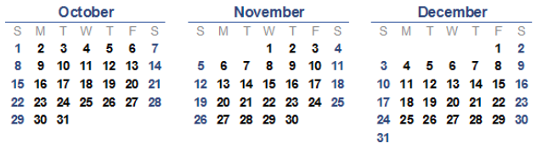


Milestone 2.0
Group meeting
Group and customer meeting
Milestone 2.0 due date
Started work on Milestone 2.0

Slide 4



Requirements
customer statement
listed all the functions needed
divided to small user stories
Notes:
Started with a problem statement from the customer.
Customer has listed all the functions needed.
The function then were identified by the team and divided to small user stories
The user stories were presented to the customer to eliminate any assumption and to ask more question regarding the requirements.
Customer were asked to prioritize the functions for the Milestone 1.0 .

Slide 5
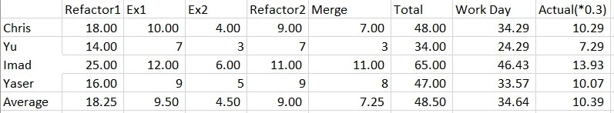
User Stories/Task Estimation
User Stories/Task Estimation 2.0
Notes:
Why did we do this: To calculated the amount of time we should actually use.
First iteration -- Second Band Assign---

Slide 6
Velocity
4(team)× 5 (working days) × 0.35 (first velocity) = 14 (days/week) 14 (amount of work in person days) × 7 (number of weeks) = 84 (days/milestone)
84(person-days/milestone) - 49(plan-poker estimation) = 35 days
Notes:
Iteration work capacity: person-days/iteration Milestone work capacity: person-days/milestone

Slide 7
Milestone 2.0/ Iterations
Title: Refactoring 1
Est: 10
Priority: 7
Velocity: 0.5
Iteration 1
Total Days: 10
Title: Second Band Assign
Est: 11
Priority: 10
Velocity: 0.3
Title: Waiting List Replace
Est: 4
Priority: 9
Velocity: 0.3
Iteration 2
Total Days: 15
Notes:
Iterations: (1 - 10) Low to High 1. Fill in the data(10), Edit the Instrument and talent(5),Check-in(5) 2Weeks
2. Dorm assign(10), Band Assign(10), 3Weeks
3. Merging all the part(8), test the software(8) Weeks

Slide 8
Milestone 2.0/ Iterations(cont.)
Title: Refactoring 2
Est: 8
Priority: 8
Velocity: 0.2
Title: “ The Merge ”
Est: 2
Priority: 8
Velocity: 0.2
Iteration 3
Total Days: 10
Notes:
3. Merging all the part(8), test the software(8) 2Weeks

Slide 9

Milestone 2.0/ Iterations (cont.)
Requirements
Design
Test
Code
Notes:
test then the code

Slide 10
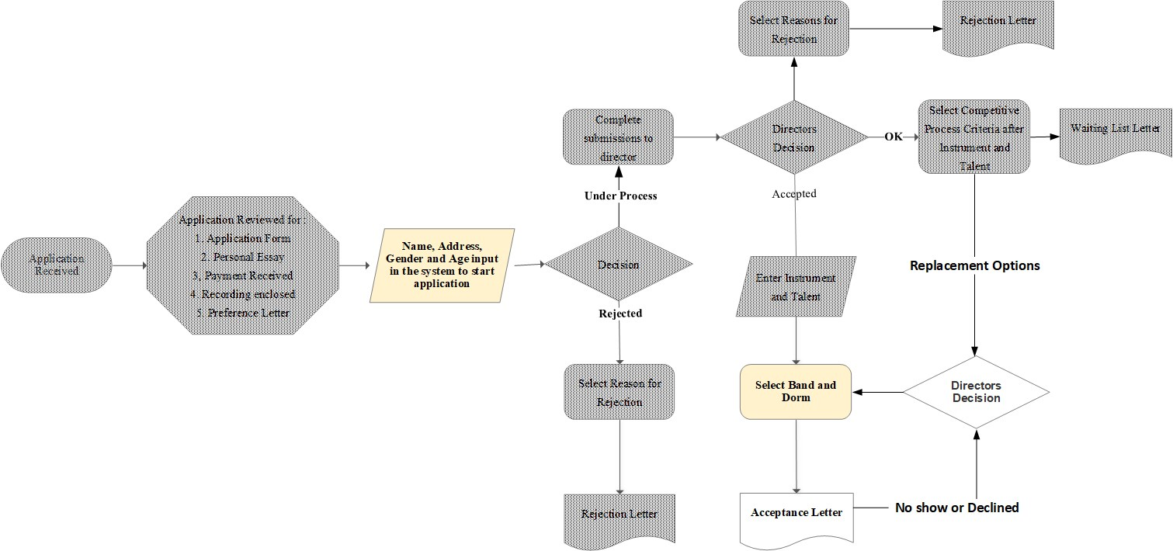
Flow Chart

Slide 11






User Stories
Band Assignment Required function
Dorm assignment
Required function
Second Band Assignment Required function
Waiting List Replace Function
Notes:
Band Assignment: Assign band to each applicant's Check the number of applicants in each band
Check the gender
Check the talent
Check the instrument
Assign band to applicant
Build band back up list Dorm assignment: Assign dorm to each applicant's
Required function: Check the number of applicants in each dorm
Check the gender
Check the age
Assign dorm to applicant
Build dorm back up list
Applicant: ID, Date, Camp, Name, Gender, Age, Essay, Payment, Recording, Decision, Dorm, Band, Talent, Instrument.

Slide 12
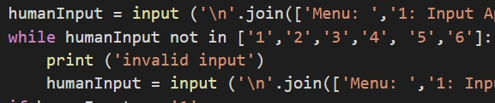
Black and Grey Box

Slide 13
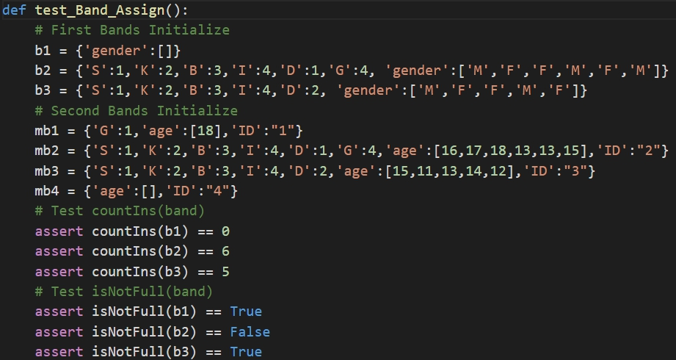
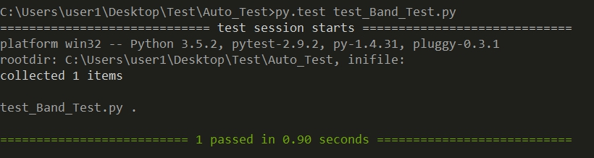
White Box Testing

Slide 14
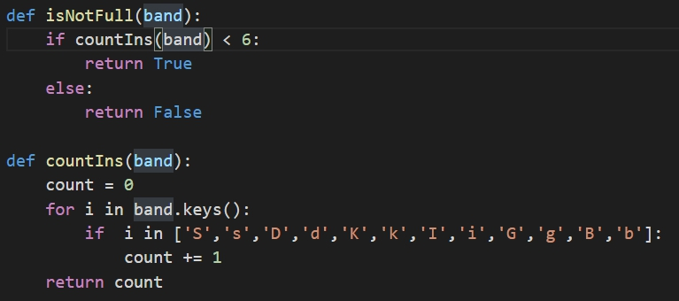
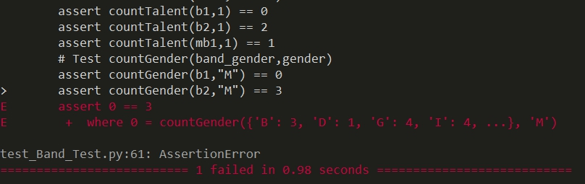
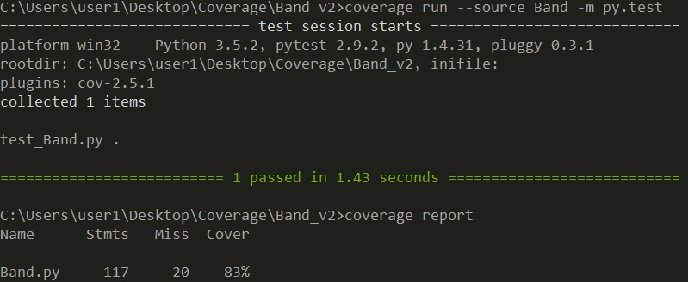
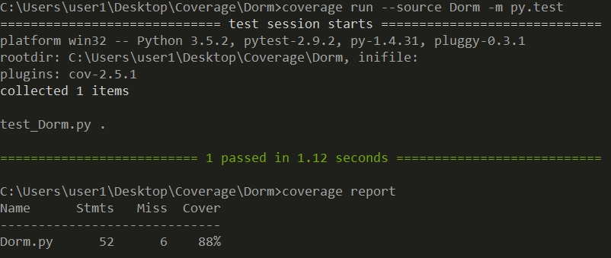
Testing cont...

Slide 15
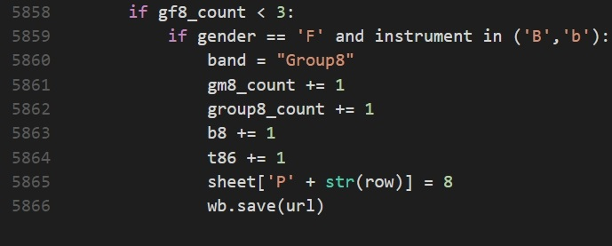
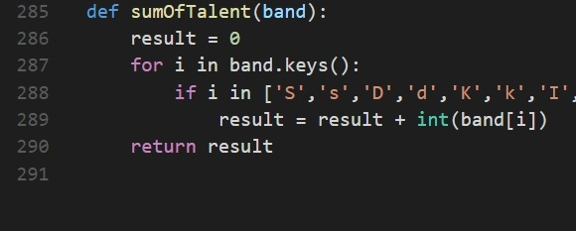
Refactoring
Before
After

Slide 16
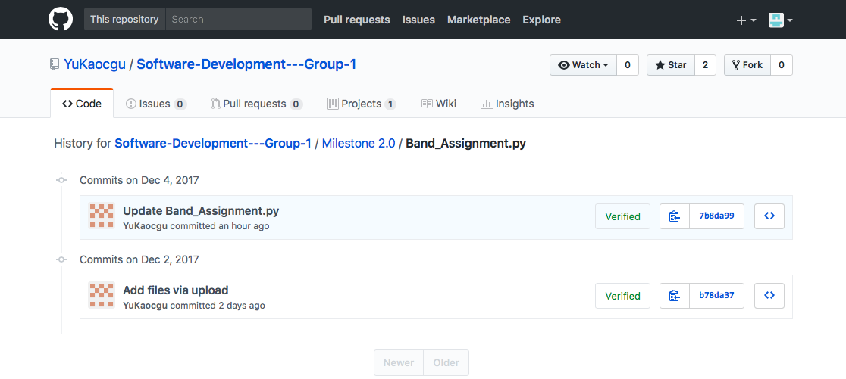
Continuous Integration

Slide 17
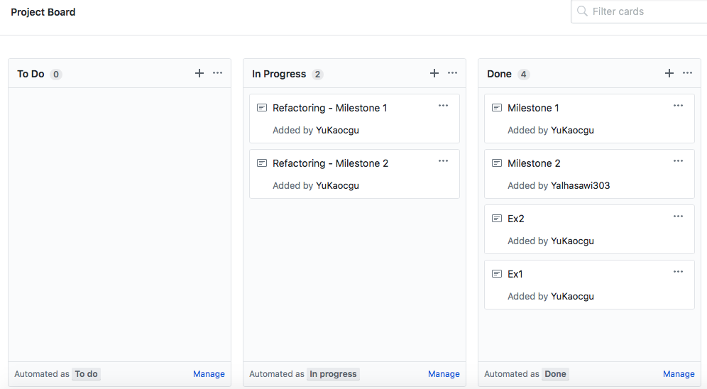


Slide 18
Demonstration

Slide 19



Slide 20
Bugs Management
¨We took notes of bugs after each iteration.
¨
¨Bugs are add to next iteration to be fixed.

Slide 21
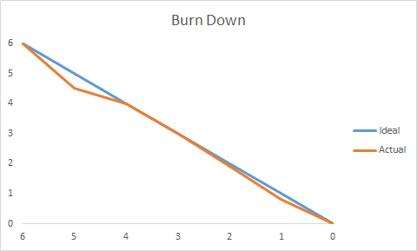
Burn Down
Milestone 1.0
Milestone 2.0

Slide 22
